Slide 1
SecurityEdu
Advisor: Vineela Kunapareddi
Jacob Gardner
Tan Nguyen
Rui Zhou
Quan Do
Nhat Le

Slide 2
Team members
Jacob Gardner - Cybersecurity researcher
BS Cyber
Tan Nguyen – Cybersecurity researcher
BS Cyber
Quan Do - Front-end developer
BS Computer Science
Nhat Le – Back-end developer
BS Computer Science
Rui Zhou– Cybersecurity researcher
BS Cyber

Slide 3
Why did we pick this
Protection against cyber threats: educating cybersecurity helps people learn how to protect themselves and their information from these threats.
Prevention of cybercrime: help prevent people from becoming victims of cybercrime and to be able to catch cybercriminals.
Improved security: help individuals and organizations better protect their systems and networks from cyber threats, reducing the likelihood of successful cyber attacks and data breaches.

Slide 4
Problem - goal - solution
Data leakage and lack security has been one of the most dangerous problems with technology implemented into all aspects of our daily lives.
Our main goal is to help users to have a resources to educate themselves about information security in different types of devices and platforms.
To achieve that, we are creating an updating website that has vulnerabilities and exploits for PCs, mobile devices, and Active Directory, so that users can use it as references to prevent cyber-attacks.

Slide 5
What makes us different?
We wanted a central site for any type of user to be able to find information that they felt was valuable to them.
This includes non-technical individuals, cyber novices, experienced cyber workers, and companies
We have multiple different levels of information that is constantly being updated by trusted sources such as Microsoft and admin users that are constantly finding new vulnerabilities and exploit articles.
Our site is also interactive with users and allows them to update articles.

Slide 6
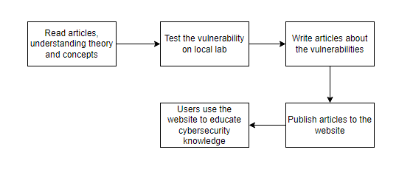
Article design
What are the concepts of the vulnerabilities?
How the vulnerabilities work?
Practical examples of the vulnerabilities on local lab.
Remediation/Mitigation
References

Slide 7
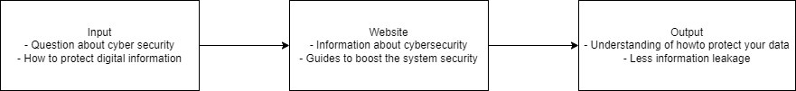
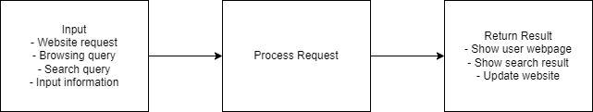
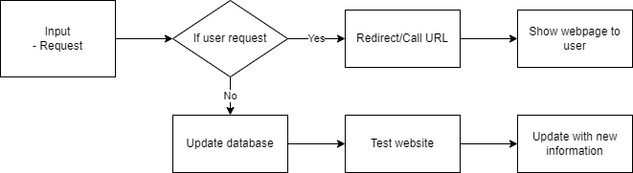
design diagrams

Slide 8




Technologies used
NextJS – Front-end
Django – Back-end
Azure – Web Hosting

Slide 9
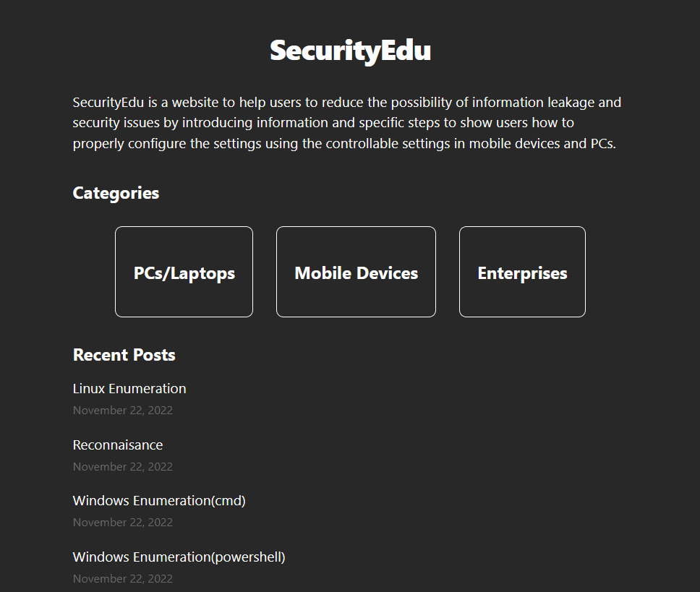
Walking through the app

Slide 10
FAQ + Search Feature

Slide 11
3RD-PARTY API

Slide 12
Admin workflow

Slide 13
Azure Hosting
The website is accessible through the link
http://securityedu.eastus.cloudapp.azure.com/

Slide 14
Conclusion
Our overall goal was to give people a platform to learn and grow in the world of cyber no matter what level of experience they may have.
We all have a background in IT and agreed we would like a source like this to learn.
Wanted it to be interactive with users to create a better connection and learning experience.

Slide 15
Sources
“Everything You Should Know about the Dark Web.” Tulane School of Professional Advancement, 29 June 2021, https://sopa.tulane.edu/blog/everything-you-should-know-about-dark-web.
The State of Cybersecurity By Darren Guccione, and Darren Guccione. “What Is the Dark Web? How to Access It and What You'll Find.” CSO Online, CSO, 1 July 2021, https://www.csoonline.com/article/3249765/what-is-the-dark-web-how-to-access-it-and-what-youll-find.html.
“Microsoft.” Microsoft Support, https://support.microsoft.com/en-us/account-billing/how-to-use-two-step-verification-with-your-microsoft-account-c7910146-672f-01e9-50a0-93b4585e7eb4.
Shyamsundar, Teju. “What Is Two-Factor Authentication (2FA)? .” Okta, Okta Inc., 9 Mar. 2022, https://www.okta.com/blog/2021/07/what-is-two-factor-authentication-2fa/.
Iainfoulds. “Active Directory Domain Services Overview.” Microsoft Learn, https://learn.microsoft.com/en-us/windows-server/identity/ad-ds/get-started/virtual-dc/active-directory-domain-services-overview.
Shyamsundar, Teju. “What Is Two-Factor Authentication (2FA)? .” Okta, Okta Inc., 9 Mar. 2022, https://www.okta.com/blog/2021/07/what-is-two-factor-authentication-2fa/.

Slide 16
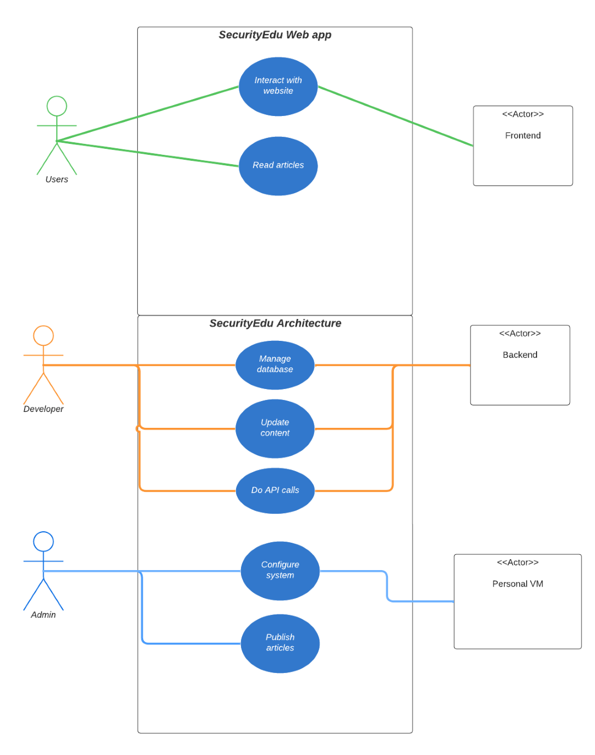
user stories
As a general user, I want to learn about cybersecurity, so that I can protect my digital information online.
As a security specialist, I want to learn about possible attack, so that I can implement prevention methods.
As a company, I want to boost company's security, so that I can prevent information leakage.

Slide 17
Mobile devices
General users-recognize the dangers of these topic and can learn how to Methods for detection and defense.
Malware, Public Wi-Fi, NFC vulnerabilities, etc.
Developers(with relevant experience)-A user with a developer role can harvest content after reading it, and then apply it to his project.
Cross Site Scripting, Cross Site Request Forgery, etc.

Slide 18
Intro
First of all, our initial idea is to pay attention to various groups around us who lack security knowledge. Because of the abundance of electronic devices today and the affluence of the Internet age. People only see various conveniences and advantages, but fail to pay attention to the leakage of personal information and the emergence of security problems behind them.
Our solution is to make a website that can read information for various users and use different methods to prevent cyber attacks that may occur on mobile devices, PCs and websites, helping users reduce the possibility of information leakage and security issues sex. This information can help users increase their knowledge to better understand and prevent threats that may occur when using computers, administering servers, and developing web applications. It can also allow more people to pay attention to current safety issues and learn how to prevent and deal with them.

Slide 19
Goals
Educate users about information security
Improve awareness of internet security and technology security
Help users protect their devices from cyber attacks
Help business protect their servers from cyber attacks

Slide 20
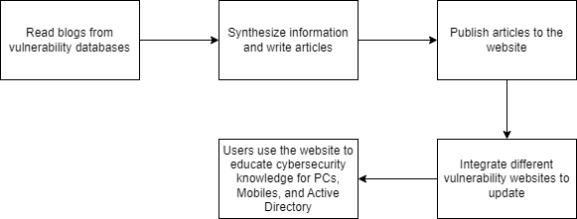
Methodology

